Slide 1
Routing Algorithm
Prof. Ramesh Ragala

Slide 2
Network Layer
Design issues
Routing
Congestion
Internetworking
Internet Protocols
Multimedia or QoS

Slide 3
Design issues
Goal of layer: get packets from source host to destination host
Routing: should know about topology of subnet
Congestion: should avoid overloading some communication lines and routers
Quality of service: offer the appropriate service
Internetworking: deal with network differences, if source and destination are connected to different networks

Slide 4
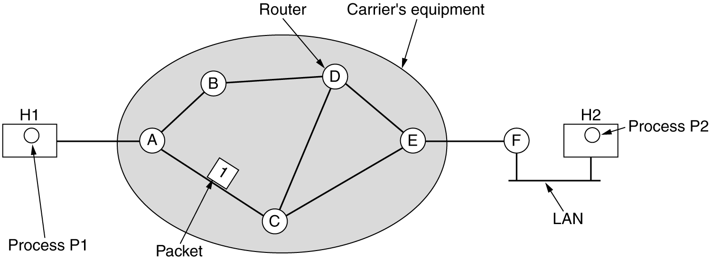
Design issues
Store-and-forward packet switching
Equipment of: carrier <> customer
Algorithm at router
Receive packet
Check packet (e.g. checksum)
Forward packet

Slide 5
Routing Algorithms
Properties
Shortest Path Routing
Flooding
Distance Vector Routing
Link State routing
Hierarchical routing
Broadcast routing
Multicast routing

Slide 6
Routing Algorithms
Purpose of Routing
However , all nodes in the network are not directly connected.
Nodes in the network must forward the information to other nodes.
The process of determining where to forward packets and actually doing is called routing.
Session Routing.
Each router has two processes.
1. one process handles incoming packets and forwarding
2. other process update and fill the routing table.

Slide 7
Routing algorithms
Desirable properties
Correctness
Simplicity
Robustness: able to cope with
changes in topology, load
hardware and software failures
Stability
Converge to equilibrium
Fairness
Optimality
}
all algorithms
⎫⎬⎭
hard to achieve
}
conflicting

Slide 8
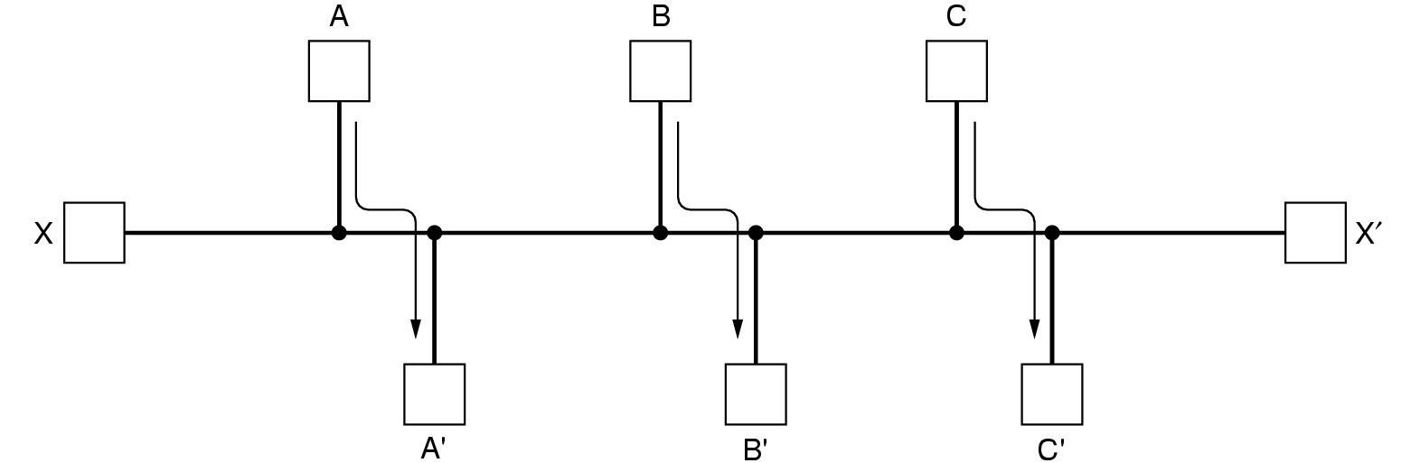
Routing algorithms
Desirable properties (cont.)
Fairness
Optimality
Conflict!

Slide 9
Routing algorithms
Taxonomy
Non adaptive (static Routing)
Routing decisions computed in advance, off-line and downloaded
Adaptive
To changes in
Topology
Load
Get information
Locally
From adjacent routers
From all routers

Slide 10
Routing algorithms
Principle of Optimality
It is a general statement about optimal route with out regard to network topology or traffic.
It states that, if a router – J is on the optimal path from router – I to router – K, then the optimal path from J to K also falls along the same route.
The set of optimal routes from all sources to a given destination form a tree is called sink tree. The root of the sink is a destination node.

Slide 11
Routing algorithms
Optimality principle
Optimal path from I to K over J
I 
● K
d₁
distance
d₂
d₁ + d₂ is minimal
J
●
d₃
Other path from J to K
d₃ > d₂
as
d₁ + d₃ > d₁ + d₂
Set of all optimal routes
from all sources
to a given destination
is a tree: sink tree

Slide 12
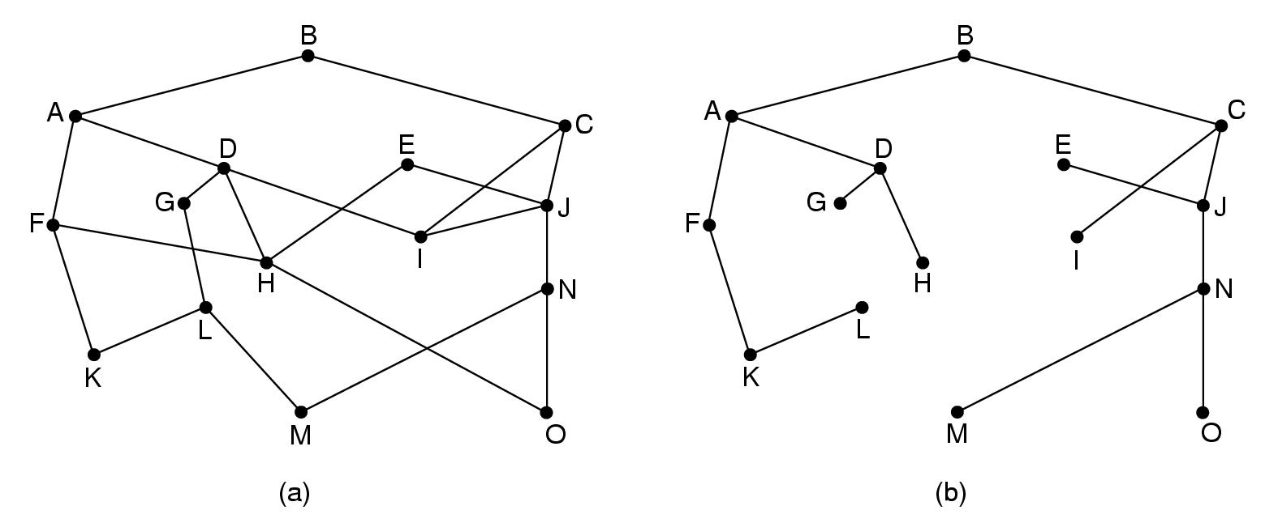
Routing algorithms
Optimality principle: sink tree
Destination

Slide 13
Routing: shortest path
Algorithm of Dijkstra: shortest path in graph → static algo
Graph for a subnet
Node = router
Arc = communication line
Metric
Number of hops
Geographic distance
Mean queuing and transmission delay
Initially, no paths are known, so all nodes are labelled with infinity. These are temporary labels.
As algorithm, proceeds the path found, the label values are changes. → gives the better paths.
Label may be tentative or permanent. Initially all labels are tentative. After applying algorithm, label are permanent.

Slide 14
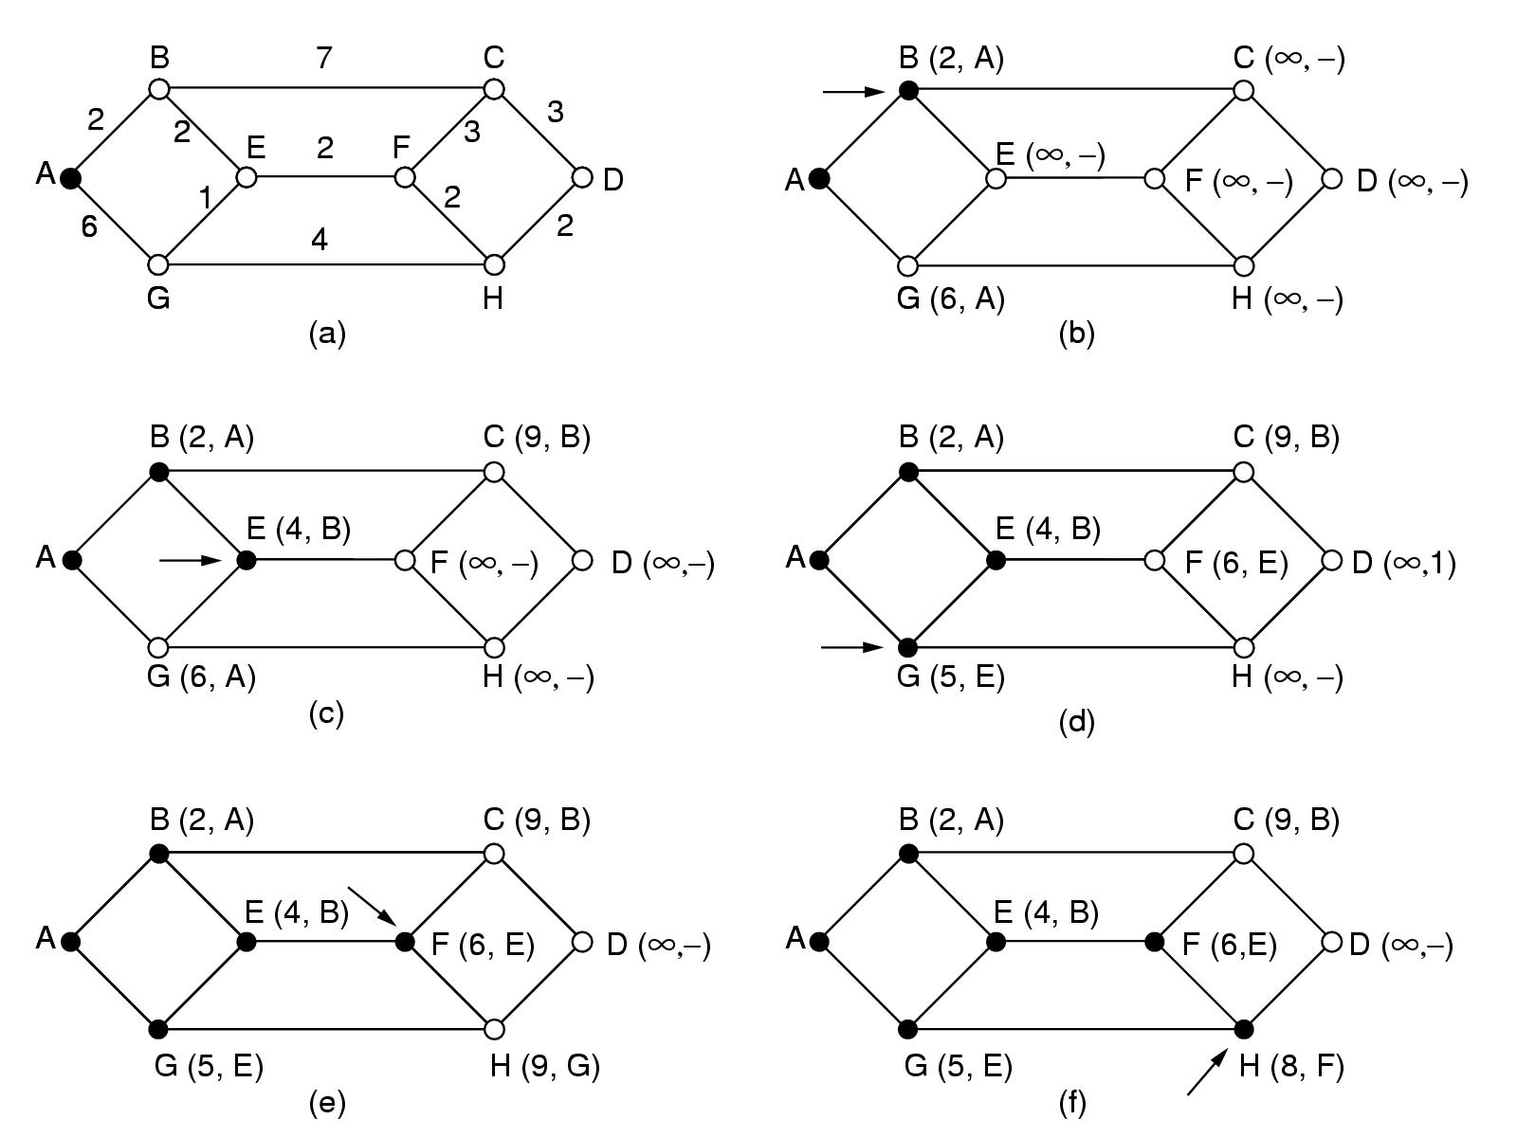
Routing: shortest path
Initial node
Elements of algorithm:
Mark all nodes as free: 
Mark initial node as selected: 
repeat till destination is selected:
Label all free nodes reachable from selected nodes with shortest distance to a selected node
Select free node with shortest distance to a selected node and mark it as selected

Slide 15
Routing: shortest path

Slide 16
Routing: flooding
Every packet is sent out on every outgoing line except the one it arrived at

Slide 17
Routing: flooding
Every packet is sent out on every outgoing line except the one it arrived at

Slide 18
Routing: flooding
Every packet is sent out on every outgoing line except the one it arrived at

Slide 19
Routing: flooding
Every packet is sent out on every outgoing line except the one it arrived at

Slide 20
Routing: flooding
if node 1 has a packet to send to node 6, it send a copy of that packet (with a destination address of 6), to nodes 2, 3, and 4.
Node 2 will send a copy to nodes 3 and 4.
Node 4 will send a copy to nodes 2, 3, and 5. And so it goes.
Eventually, a number of copies of the packet will arrive at node 6.

Slide 21
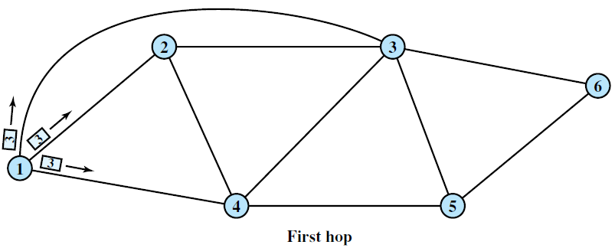
Routing: flooding

Slide 22
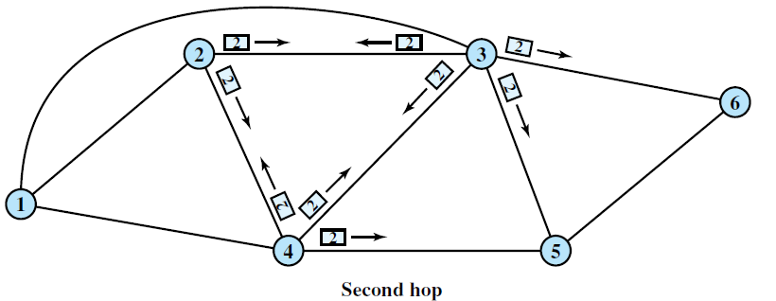
Routing: flooding

Slide 23
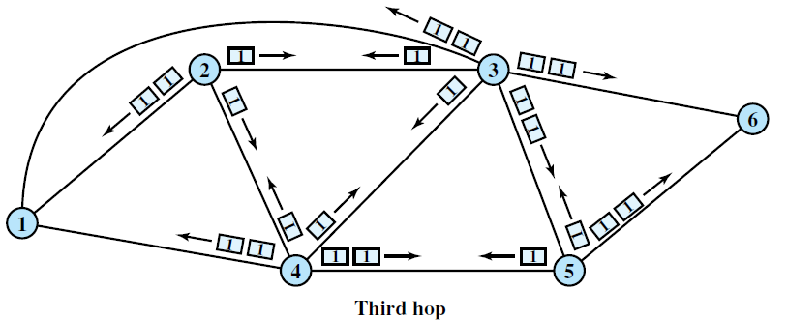
Routing: flooding

Slide 24
Routing: flooding
Every packet is sent out on every outgoing line except the one it arrived at
Duplicates!! How to limit?
Hop counter
Decrement in each router
Discard packet if counter is 0
Initialisation?
Sequence number in packet
Avoid sending the same packet a second time
Keep in each router per source a list of packets already seen
Useful?

Slide 25
Routing: flooding
Every packet is sent out on every outgoing line except the one it arrived at
Sometimes useful
Robust algorithm: e.g. military applications
Broadcast
Comparison purposes: always shortest path
Selective flooding
Use only those lines that are going approximately in right direction
Still working?

Slide 26
Routing: distance vector (Bellman ford algorithm)
Adaptive algorithm
Exchange of info only with neighbours
Data to be available in each router
Routing table: per destination
Distance
Outgoing line
Distance to all neighbours
another name → Ford Fulkerson algorithm (1962)
It is developed for ARPANET. Now it is also used in Internet with a name RIP

Slide 27
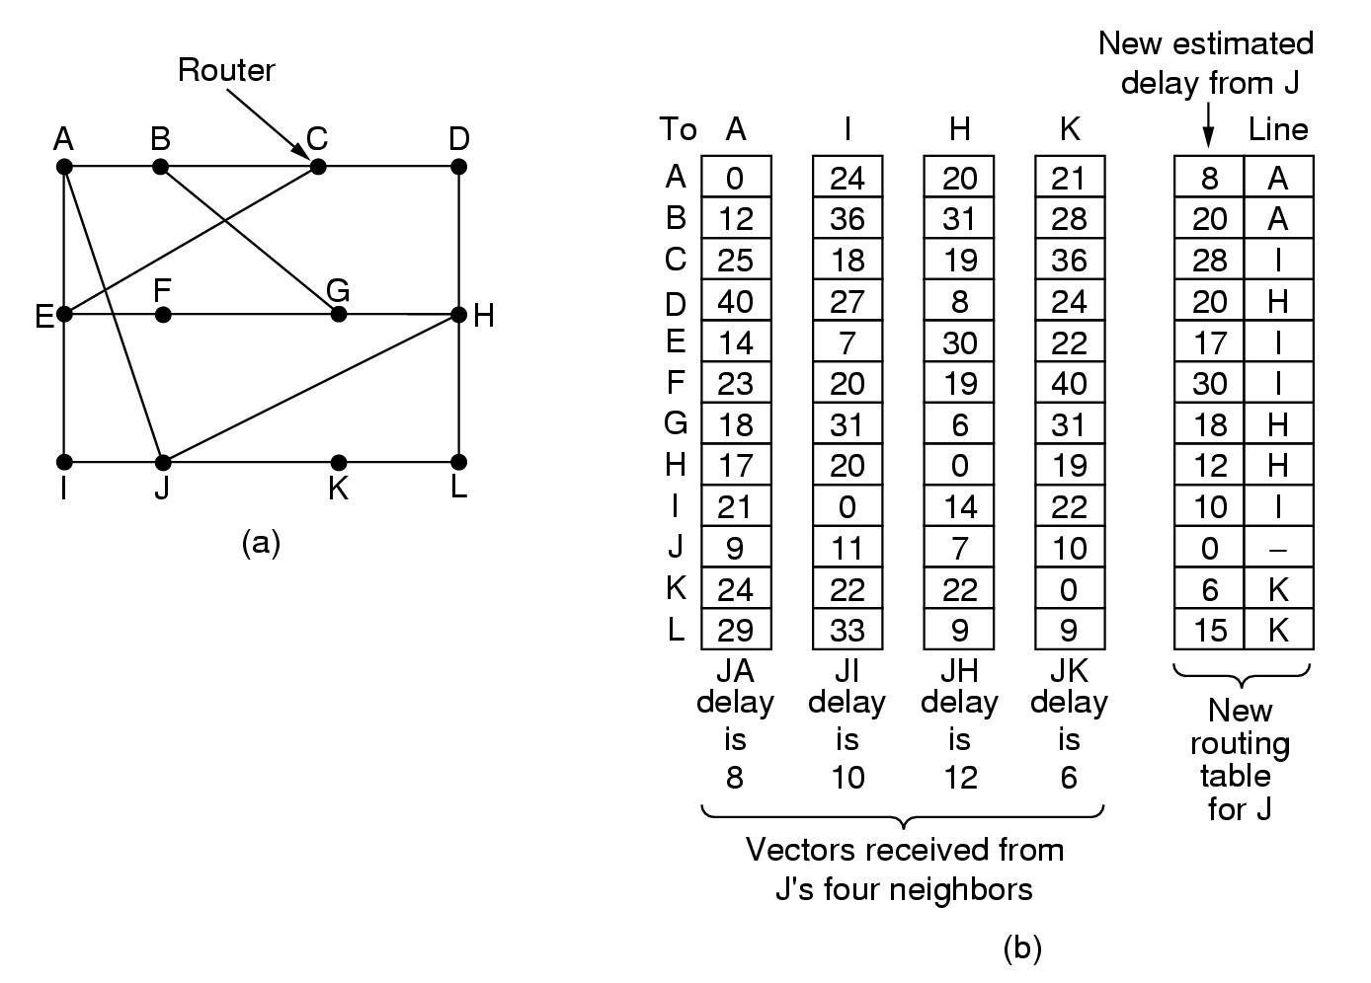
Routing: distance vector
Routing table for A
To | cost | via
A | 0 | -
B | 12 | B
C | 25 | B
D | 40 | B
E | 14 | E
F | 23 | E
G | 18 | B
H | 17 | J
I | 21 | E
J | 9 | J
K | 24 | J
L | 29 | J

Slide 28
Routing: distance vector
Algorithm
At each step within a router:
Get routing tables from neighbours
Compute distance to neighbours
Compute new routing table
Characteristics:
Iterative
Asynchronous
Distributed

Slide 29
Routing: distance vector
Routing tables from

Slide 30
Routing: distance vector
Better?
Keep 4 tables (one for each neighbour)
Use shortest path

Slide 31
Routing: distance vector
Distributed algorithm
Triggers:
Change in delay to neighbour
Receive new table from neighbour
Update local tables
If changed: forward routing tables to neighbours
Asynchronous
Execution in lock step not required
Iterative
Stops?
How fast are changes propagated?
Good news?
Bad news?

Slide 32
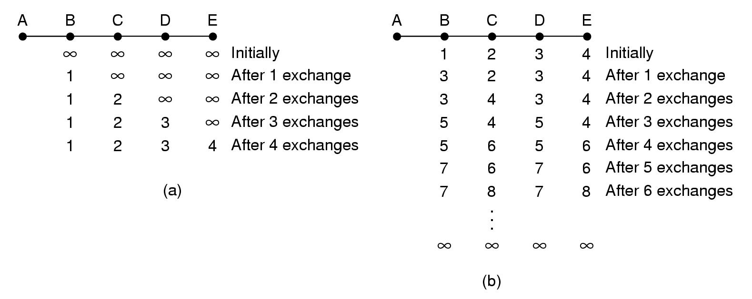
Routing: distance vector
Good news:
A comes up again
Only distances to A
Faster not possible!!!

Slide 33
Routing: distance vector
Bad news:
A goes down
B receives:
Distance ∞ from A
Distance 2 from C
New distance from B to A: 3 via C

Slide 34
Routing: distance vector
Bad news:
A goes down
C still
believes its distance to A is 2
routes via B
B routes its packets for A via C
LOOP!!!

Slide 35
Routing: distance vector
Bad news:
A goes down
Loops!!
Slow!!
∞ = 5?

Slide 36
Routing: distance vector
Split horizon hack:
Lie to neighbour about distance if routing via neighbour
A B C D E
1 2 3 4 initially
∞
∞
lie
∞ 2 3 4 1 iteration
Faster not possible!!
∞ ∞ 3 4 2 iterations
∞ ∞ ∞ 4 3 iterations

Slide 37
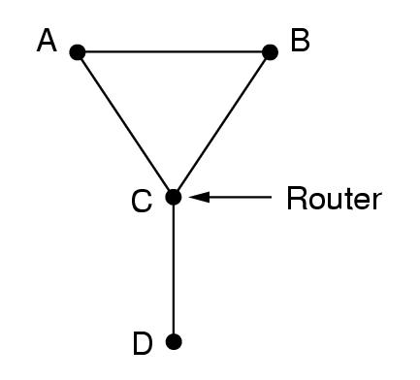
Routing: distance vector
Split horizon hack:
Hack ➔ does not always work
Example:
D goes down
A and B lie to C
A offers to B route to D
B offers to A route to D
Loops again!!!

Slide 38
Routing: link state routing
Distance Vector Routing protocols are used in ARPANET till 1979.
But it has 2 problems
1. if the delay metric is queue length, it did not take line bandwidth while choosing route.
2. count to infinity problem.
So it is replaced by entire new algorithm is called link state routing protocol.

Slide 39
Routing: link state
Overview of algorithm:
Each router must
Discover its neighbours and learn their network addresses
Measure the delay or cost to each of its neighbours
Construct a packet with these distances
Send this packet to all other routers
Compute the shortest path to every other router
The complete topology and all delays are experimentally measured and distributed to every router.
It uses Dijkstra’s algorithm to find shortest paths.

Slide 40
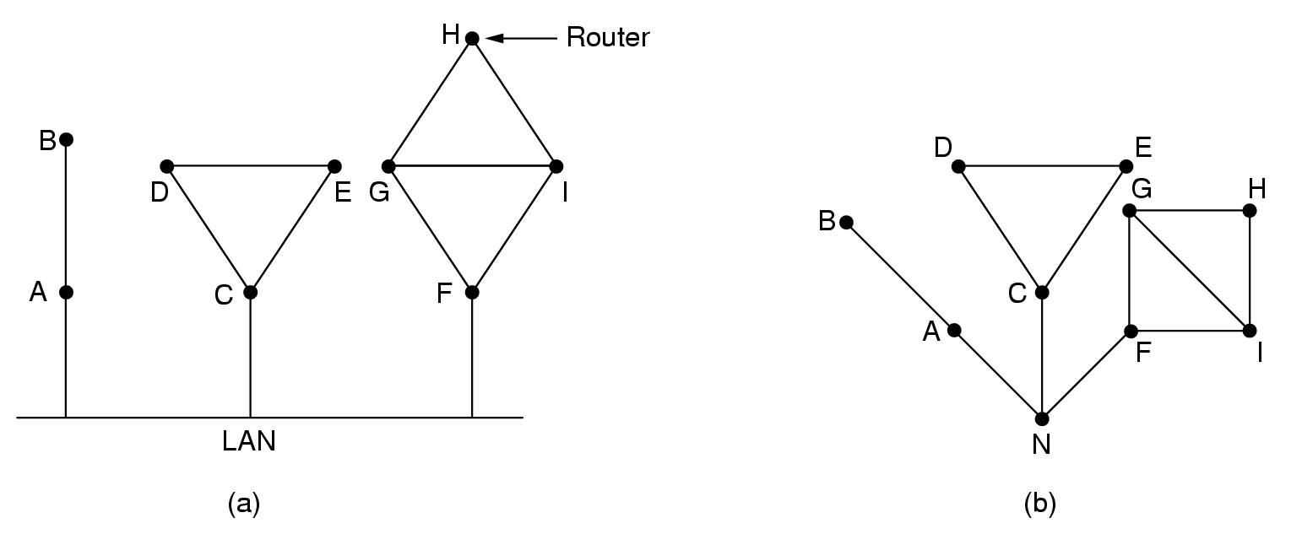
Routing: link state
Algorithm:
Learning about neighbours:
Upon boot of router
Send HELLO packet on each point-to-point line
Routers are supposed to send reply with a globally unique name
LAN model

Slide 41
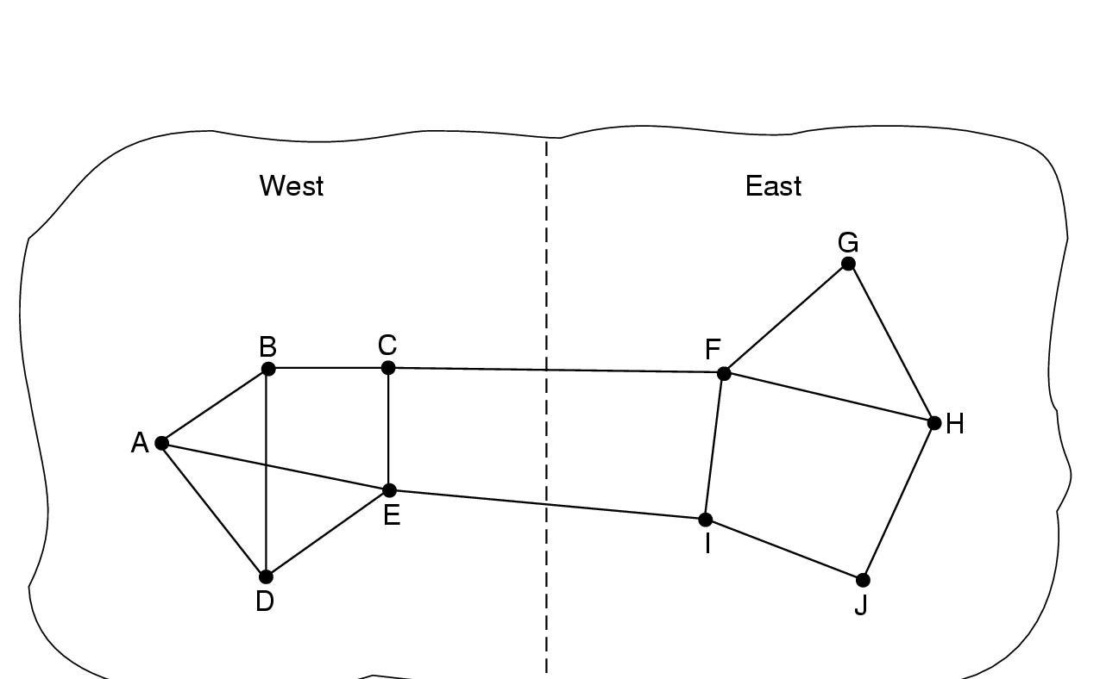
Routing: link state
Algorithm:
Measuring line cost
Measure round-trip delay of ECHO Packet and its reply
Take load into account? Arguments both ways:
Yes! preference for unloaded line
No! oscillations are possible

Slide 42
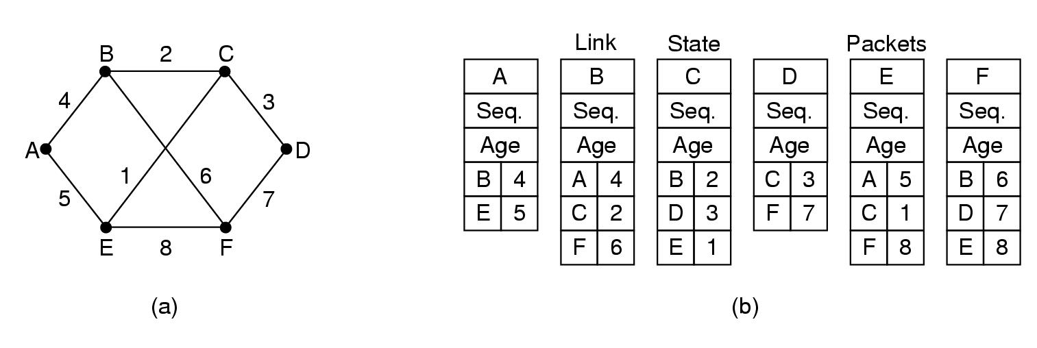
Routing: link state
Algorithm:
Building link state packets
Packet containing:
Identity of sender
Sequence number + age
For each neighbour: name + distance
When to build?
periodically
when significant events occur

Slide 43
Routing: link state
Algorithm:
Distributing link state packets
Trickiest part of algorithm
Arrival time for packets different
How to keep consistent routing tables
Basic algorithm
Flooding +
Sequence number (in each packet) to limit duplicates
Manageable problems
Wrap around of sequence numbers:
Wrong sequence number used:
lost in case of crash
Corruption
32 bits + 1 packet/sec ➔ 137 years
Age in each packet:
Decremented during flooding, while used in router
Age 0 ➔ info discarded

Slide 44
Routing: link state
Algorithm:
Distributing link state packets
Basic algorithm
Manageable problems
Refinements
Link state packets are not forwarded immediately
During holding time:
duplicates are discarded
Old packets are thrown out

Slide 45
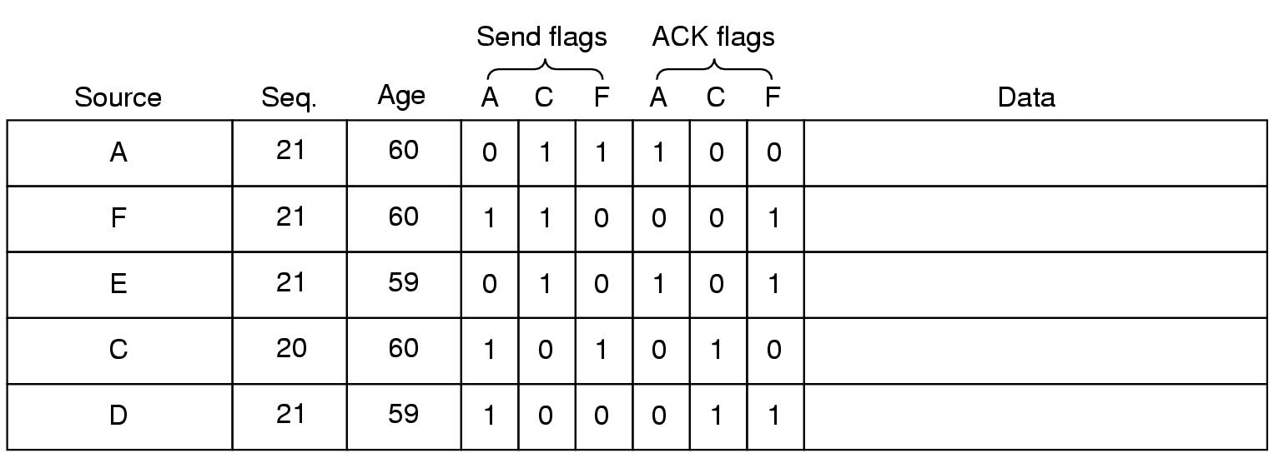
Network Layer
Packet buffer for router B
ACK flag: ACK to send
Send flag: packet to forward

Slide 46
Routing: link state
Algorithm:
Computing new routes:
With a full set of link state packets, a router can:
Construct the entire subnet graph
Run Dijkstra’s algorithm to compute the shortest path to each destination
Subnet of n router with k neighbours needed storage kn
Problems for large subnets
Memory to store data
Compute time
Big trouble if any router sends false information.

Slide 47
Routing: link state
Usage:
IS-IS protocol (another link state protocol)
Designed for DECnet, adopted by ISO
In use also in Internet
Supports multiple network layer protocols
OSPF protocol used in Internet
Common features:
Self-stabilizing method of flooding link state updates
Concept of a designated router on a LAN
Method of computing and supporting path splitting and multiple metrics

Slide 48
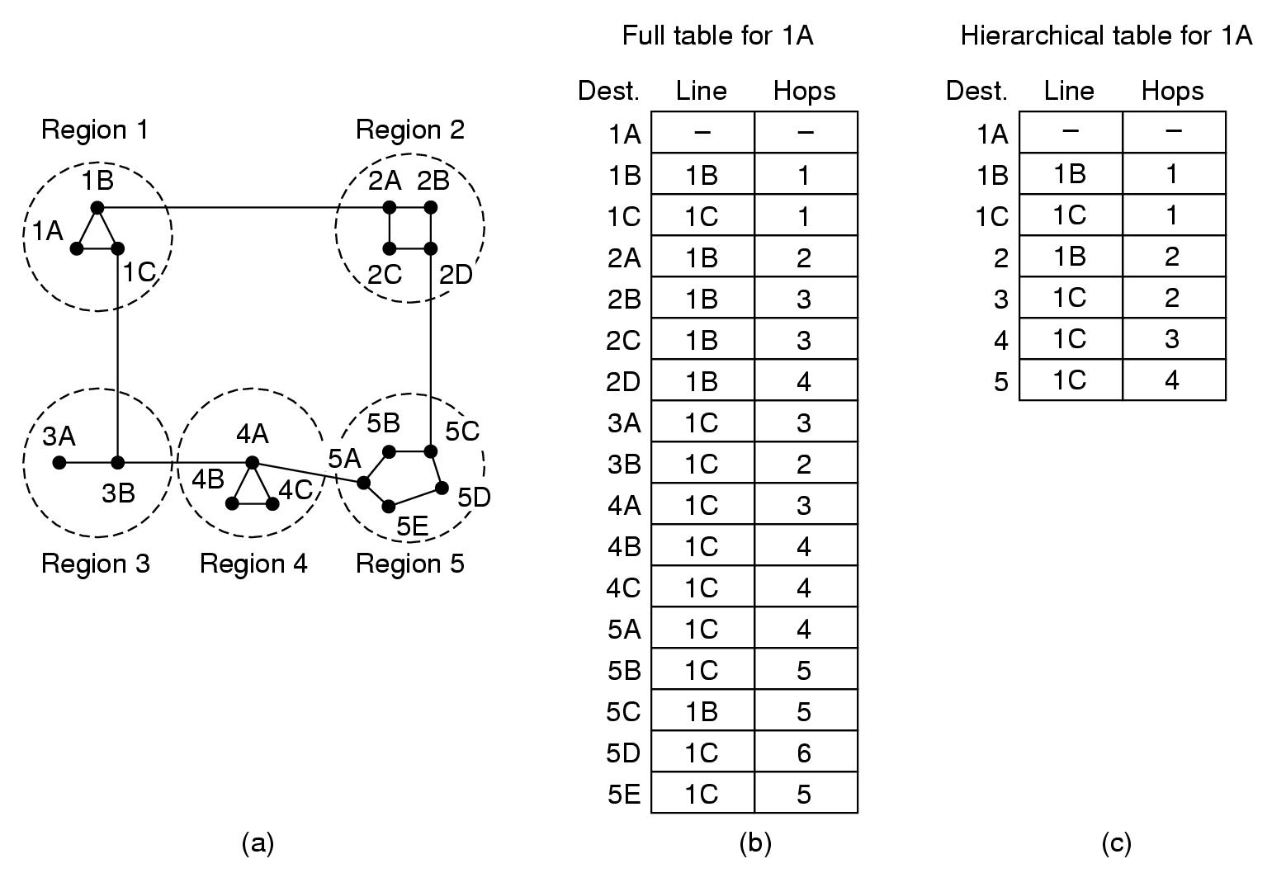
Hierarchical routing
When network size increases…
Larger stables
More CPU time needed to compute …
More bandwidth needed

Slide 49
Hierarchical routing
Solution?

Slide 50
Hierarchical routing
Optimal levels fon N router subnet is ln N requiring a total of e ln N entries per router.
Routers grouped in regions
Each routers knows how to reach:
Other routers in its own group
Other regions
Smaller tables
Longer paths

Slide 51
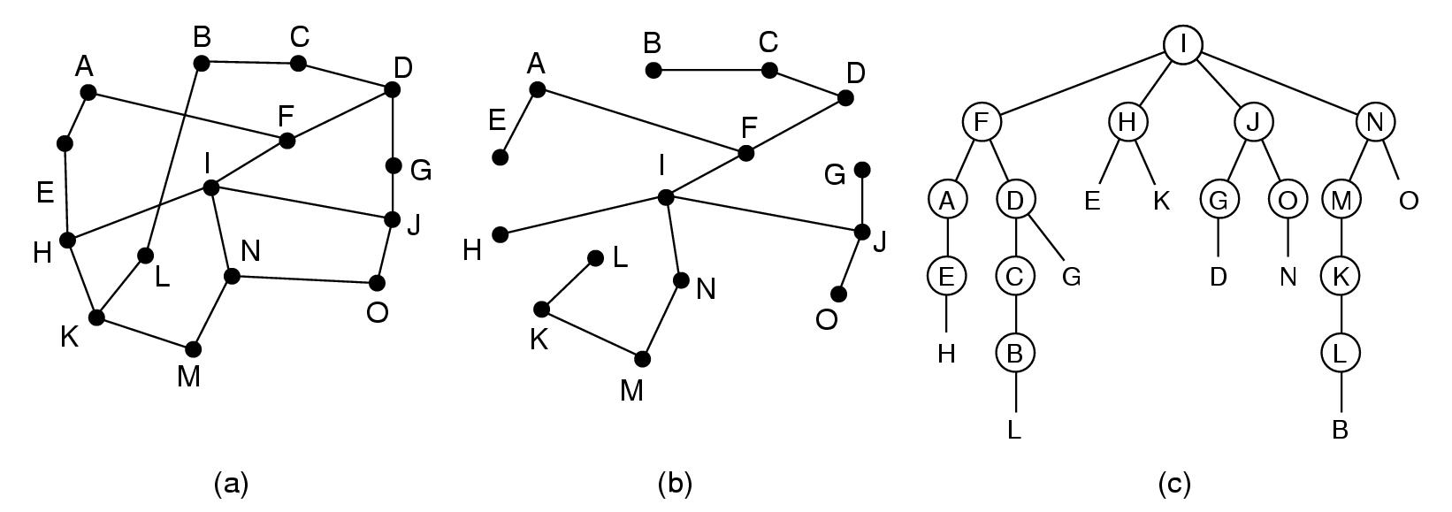
Broadcast routing
Send message to all other hosts:
Update distributed database
Distribute weather reports
Distribute live radio/TV programs
Poor methods:
Send a distinct packet to each destination
List of addresses needed
High usage of bandwidth
Flooding
Too many packets
Multidestination routing
Each packet contains a list of destination
On each line a single packet

Slide 52
Broadcast routing
Broadcast source = root of sink tree
Forwarding on sink tree lines
Excellent use of bandwidth
Source tree must be known at each intermediate node
Best method: use sink tree
Which sink tree?
How many sink trees?

Slide 53
Broadcast routing
Sink tree approximation: reverse path forwarding
if a packet arrives on line used for traffic to source of broadcast
then forward packet on all lines, except the one it arrived on
else discard packet

Slide 54
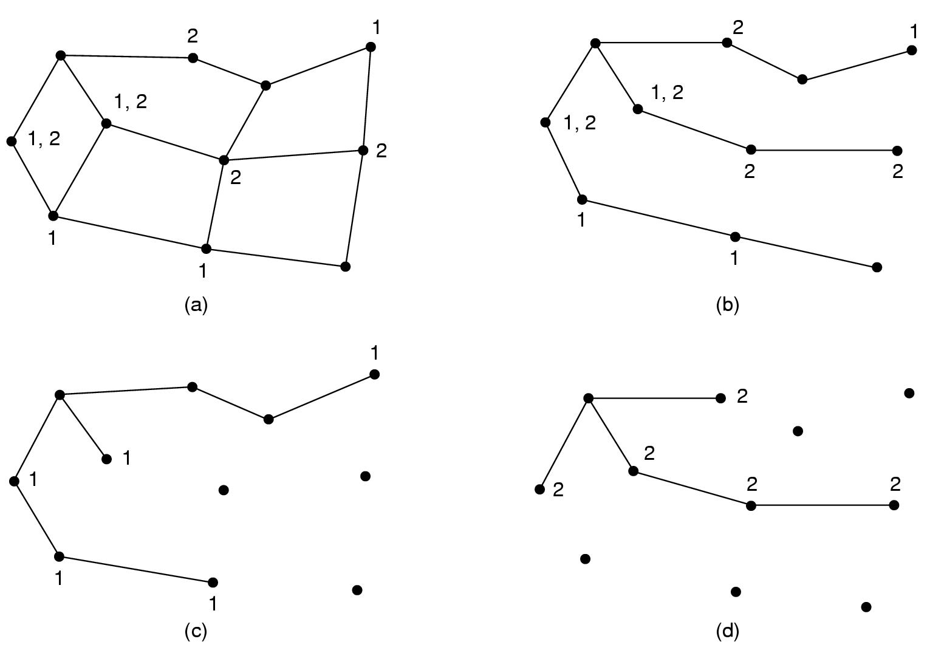
Multicast routing
Send a message to a well-defined group
Large in size
Small compared to network as a whole
Group management
Create and destroy groups
Process can leave and join a group
algorithm
How will routers know about groups?

Slide 55
Multicast routing
source
Algorithm
Source computes spanning tree
Remove lines that do not lead to hosts of group ( = pruning)
Pruning:
Link state routing
Each router knows full topology
Distance vector routing
Reverse path forwarding +
PRUNE messages to remove arcs

Slide 56
Multicast routing
source
Pruning:
Link state routing
Each router knows full topology
Distance vector routing
Reverse path forwarding +
PRUNE messages to remove arcs

Slide 57
floyd warshall algorithm
Calculates shortest path between all pairs of nodes in a network.

